Slide 2
A Gentle Introduction to AI on Azure & Machine Learning

Slide 3
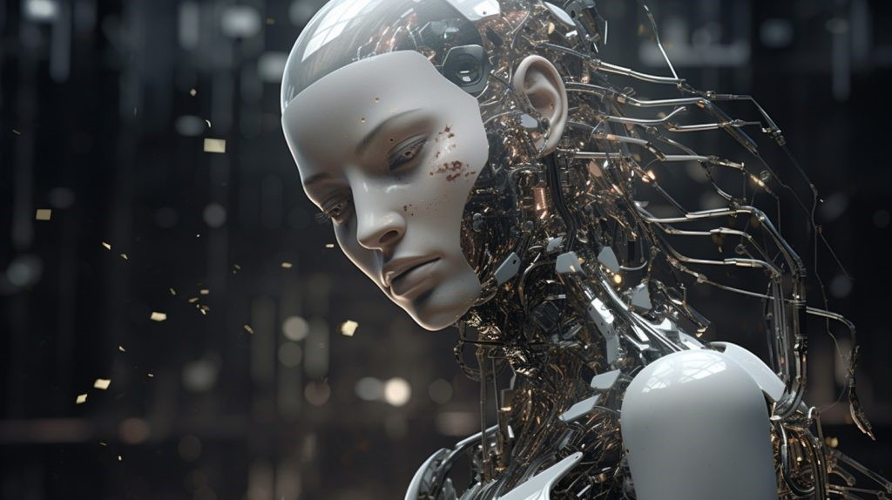
ARTIFICIAL INTELLIGENCE (AI)

Slide 4
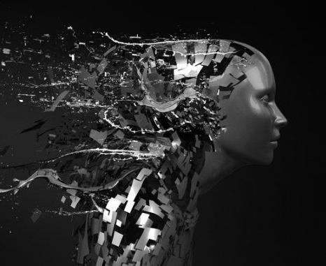
What is A.I?
Artificial Intelligence (AI) is a technology that simulates human intelligence and problem-solving capabilities, enabling computers and machines to perform tasks that would otherwise require human intervention.
It encompasses machine learning and deep learning, which develop AI algorithms modeled after the human brain's decision-making processes.
The release of ChatGPT marks a turning point in AI, with generative AI now learning and synthesizing various data types.
As AI applications grow, conversations around AI ethics and responsible AI become critical.

Slide 5
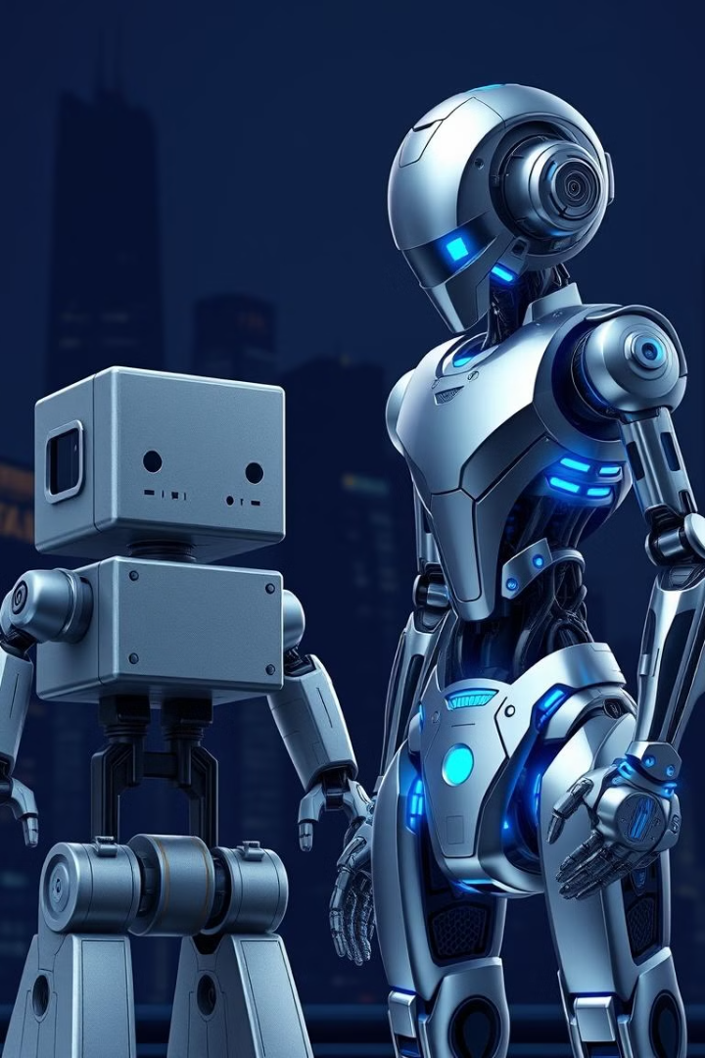
Types of Artificial Intelligence: Weak AI vs. Strong AI
Weak AI, also known as narrow AI, is trained to perform specific tasks and drives most AI today.
It enables robust applications like Siri, Alexa, and self-driving vehicles.
Strong AI consists of artificial general intelligence (AGI) and artificial super intelligence (ASI).
AGI is a theoretical form of AI where machines have equal intelligence to humans, while ASI surpasses human brain intelligence.
While strong AI is theoretical, researchers are exploring its development.

Slide 6
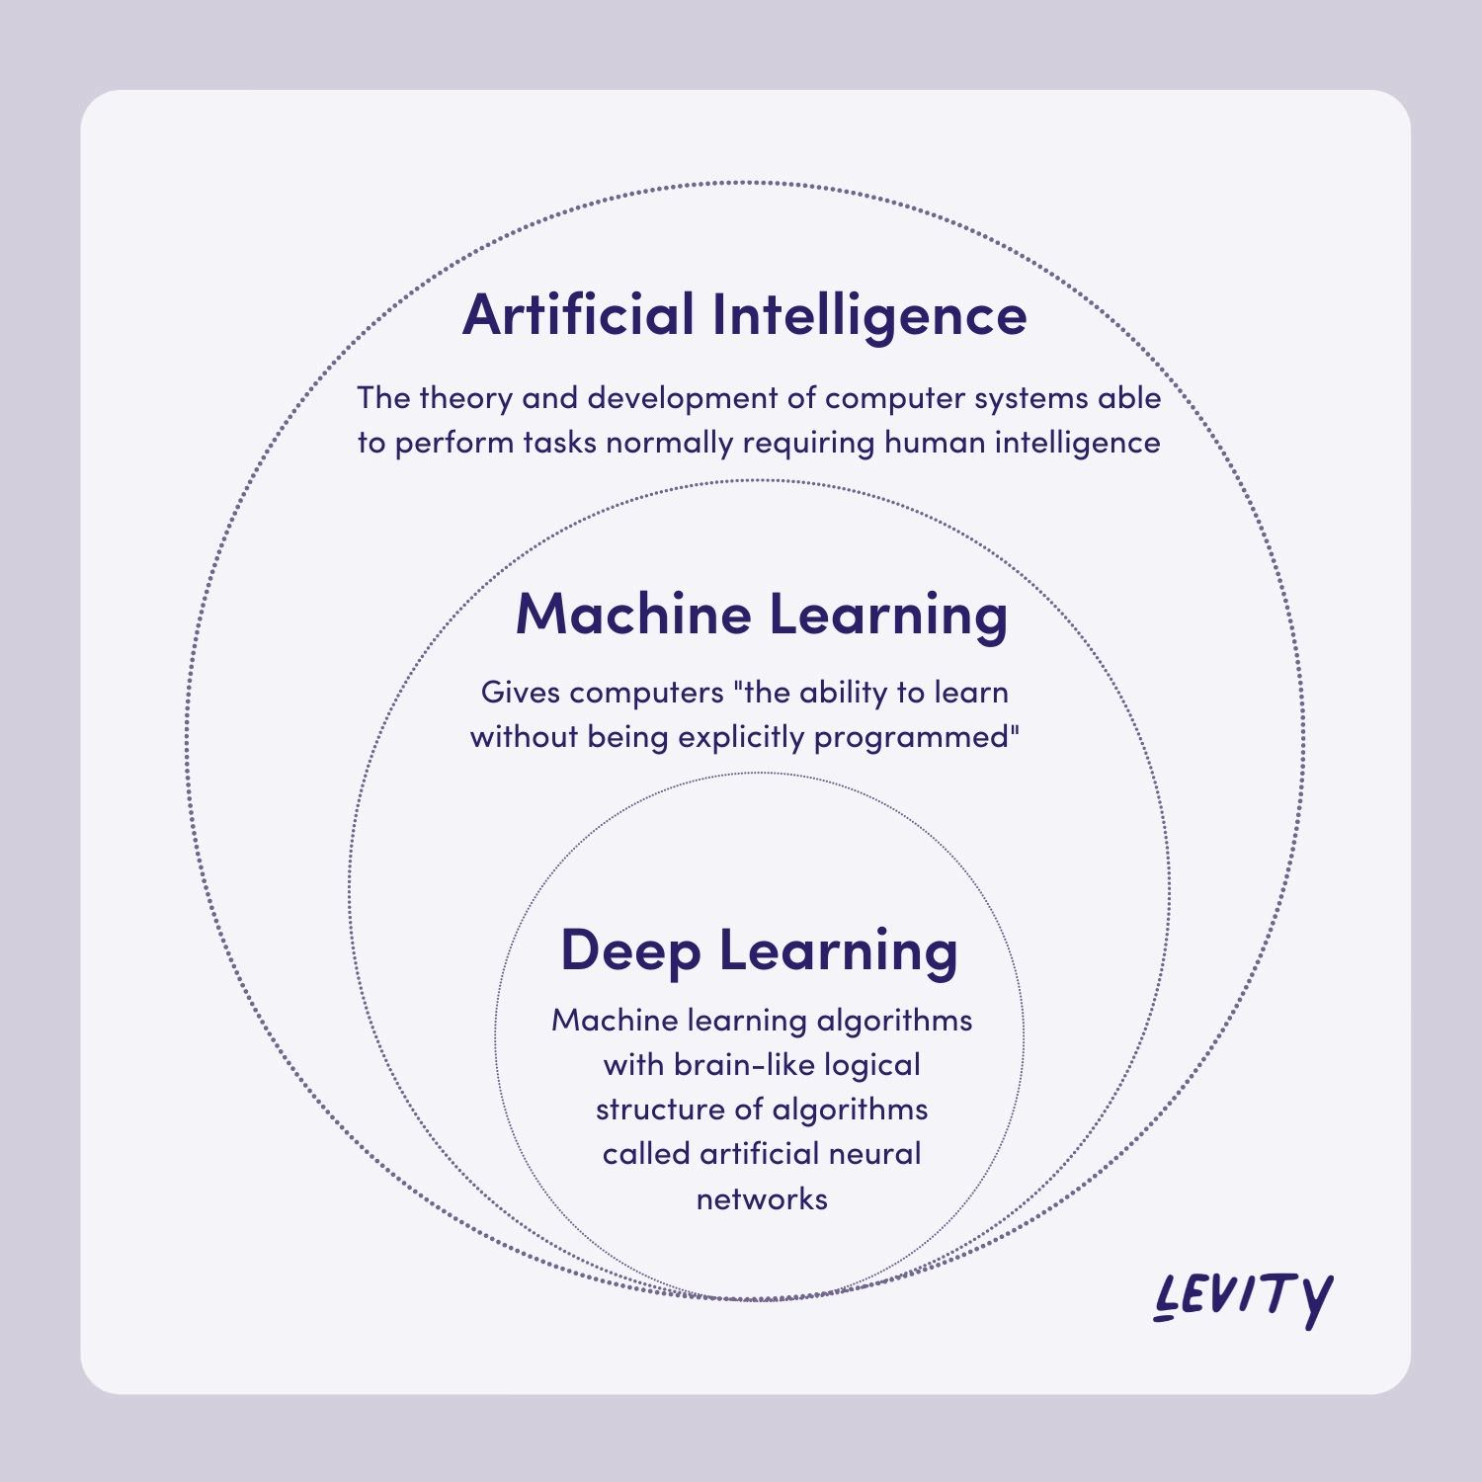

Slide 7
Deep learning vs. machine learning
Machine learning and deep learning are sub-disciplines of AI, using neural networks to learn from large amounts of data. Machine learning uses input, hidden, and output layers, typically for supervised learning.
Deep learning uses multiple layers, including an input layer, hidden layers, and output layout, for unsupervised learning.
These layers automate feature extraction from large, unlabeled, and unstructured data sets, enabling machine learning at scale without human intervention.

Slide 8
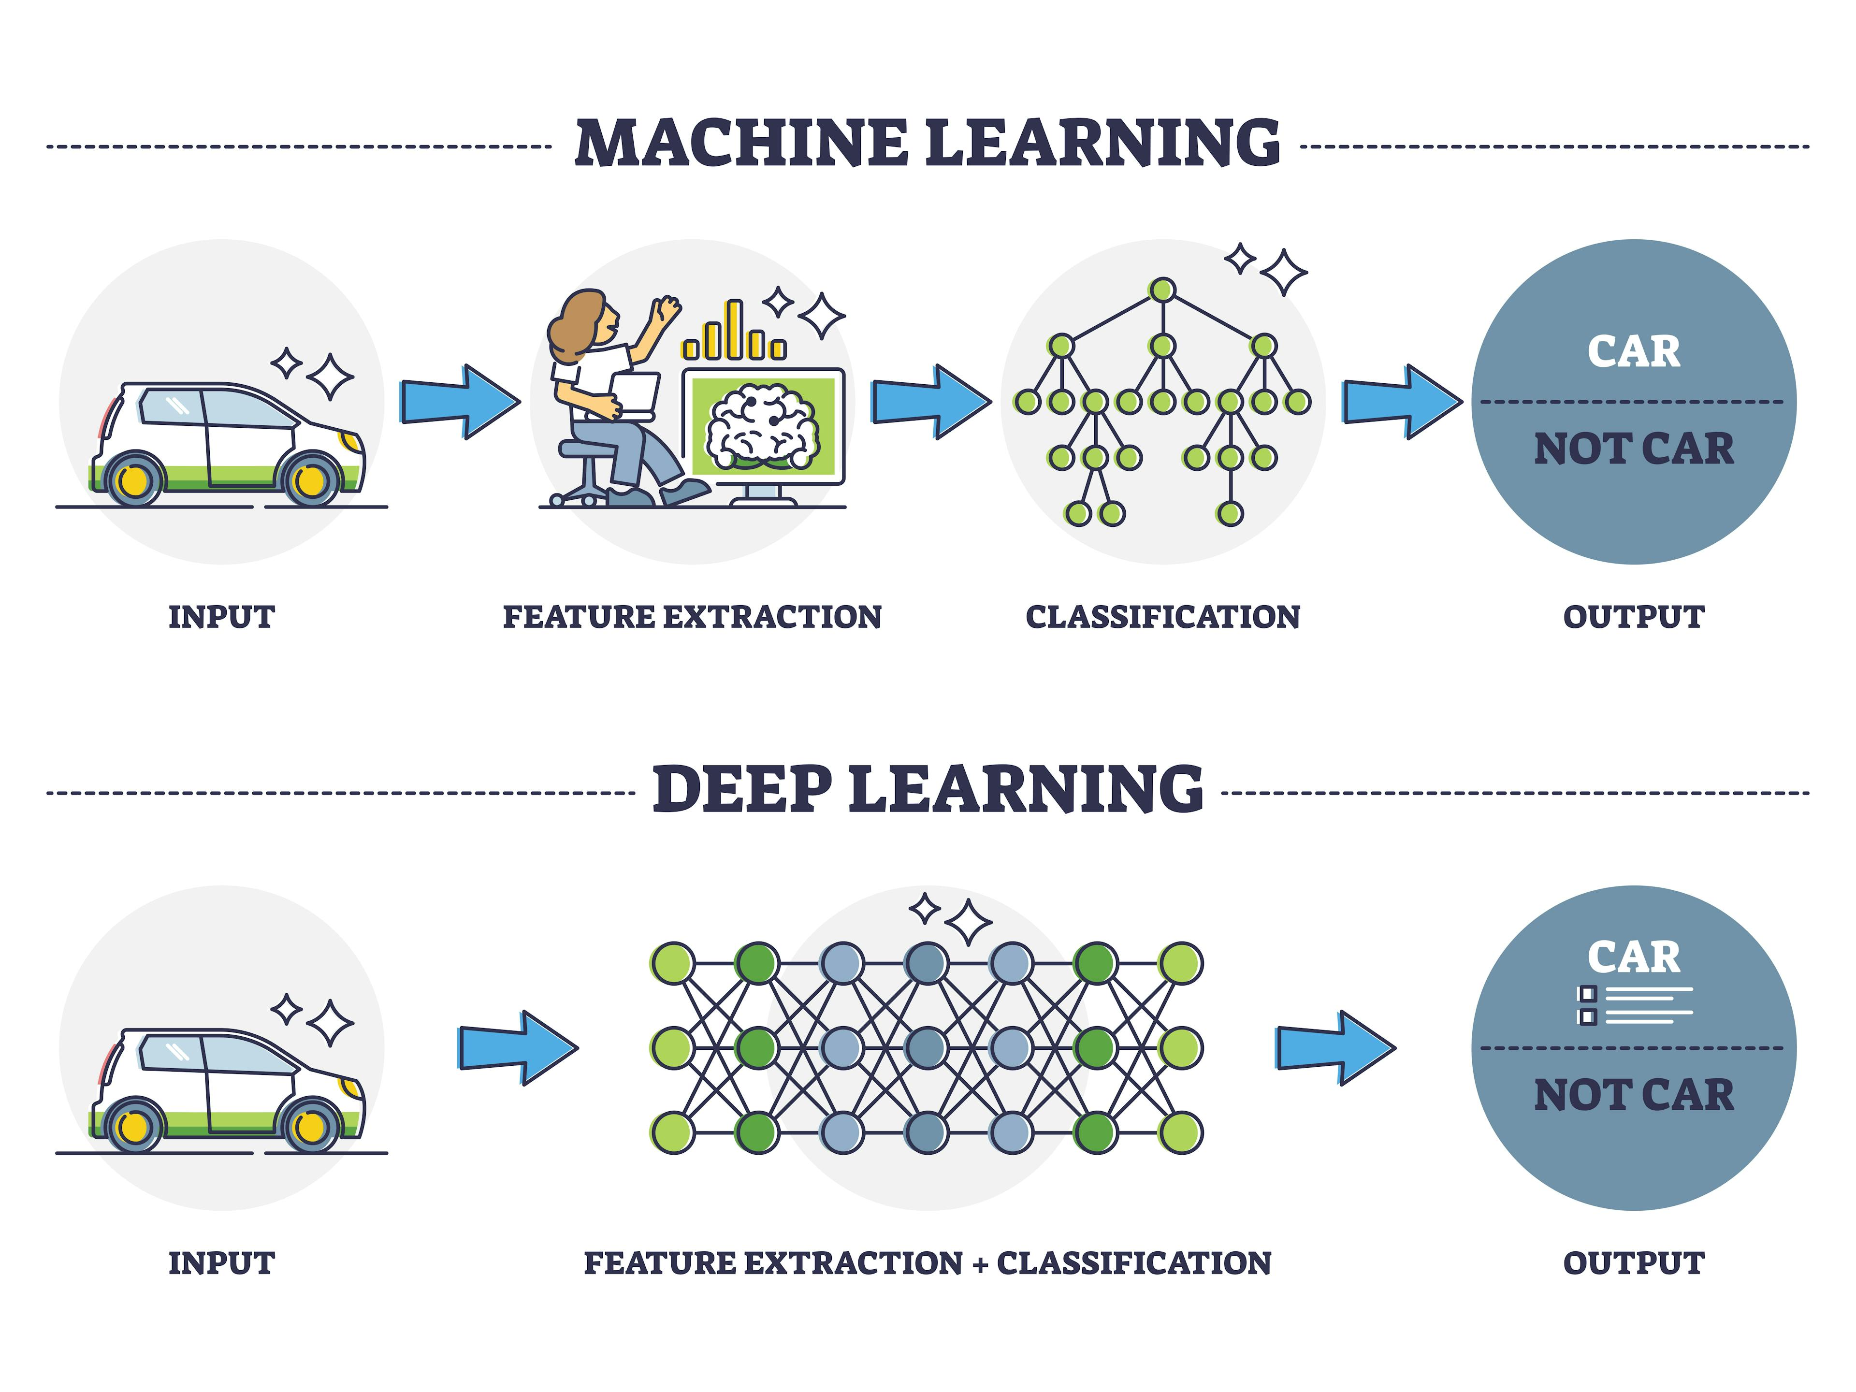
Deep Learning VS Machine Learning

Slide 9
Azure AI & Azure OpenAI

Slide 10
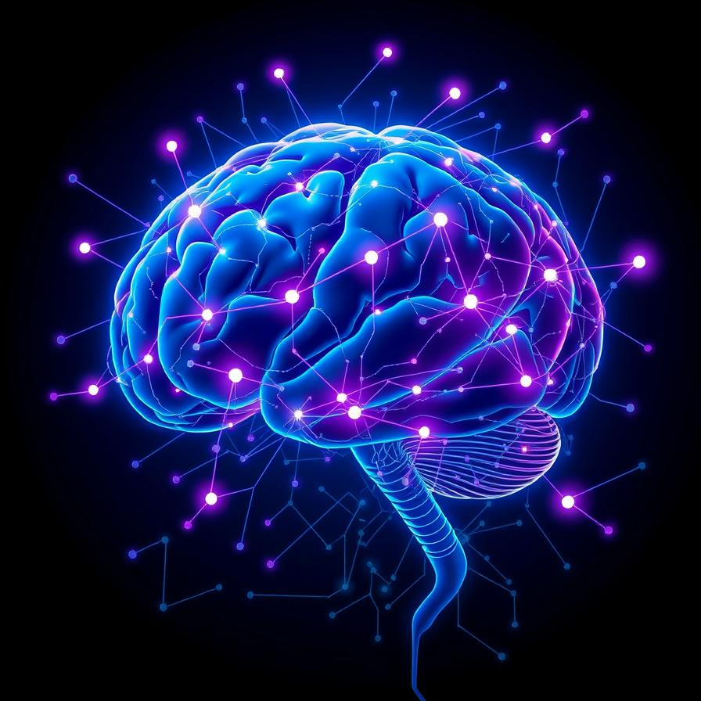
Azure AI

Slide 11
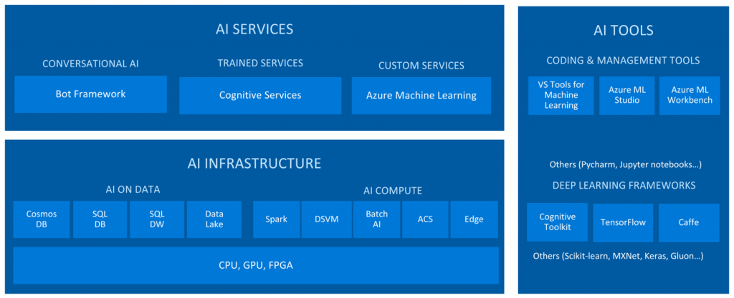
Azure AI
Collection of services that Microsoft offers as part of its cloud platform

Slide 12
















Applications
Partner Solutions
Business Users
Application Platform
AI Builder
Power BI
Power Apps
Power Automate
Power Virtual Agents
Scenario-Based Services
Applied AI Services
Bot Service
Cognitive Search
Form Recognizer
Video Indexer
Metrics Advisor
Immersive Reader
Customizable AI Models
Azure OpenAI
Service
Cognitive Services
Developers & Data Scientists
Vision
Speech
Language
Decision
ML Platform
Azure Machine Learning
Notes:
let's explore the Azure AI platform, designed to cater to both data scientists and AI developers across various industries. Imagine the platform as a layered structure, each level serving different needs and capabilities.At the foundational level, we have Azure Machine Learning. This forms the base of our platform, empowering data scientists with tools to build, train, and deploy machine learning models efficiently in the cloud.Moving up the platform, we encounter Cognitive Services. These services provide pre-built AI capabilities that developers can easily integrate into their applications. They include functionalities like vision recognition, language understanding, and decision-making APIs.Recently, at Build 2021, Azure introduced a new category called Applied AI Services. This addition was driven by direct customer feedback, aiming to offer specialized AI solutions tailored to specific industry needs. This expansion highlights Azure's commitment to refining AI applications based on real-world use cases.In November 2021, Microsoft took a significant step forward with the Azure Open AI Service. This initiative integrates advanced AI capabilities into Microsoft's own products, enhancing their functionality and intelligence. This integration marks a strategic move towards embedding AI seamlessly into everyday business processes.Fast forward to January 2023, when the Open AI platform became generally available. This milestone included the release of ChatGPT, a powerful AI model designed for natural language understanding and generation. This addition further enriches Azure's AI ecosystem, offering cutting-edge conversational AI capabilities to developers and businesses alike.In summary, Azure AI platform evolves from foundational machine learning tools to sophisticated cognitive services and specialized applied AI solutions. With the introduction of Open AI Service and subsequent innovations like ChatGPT, Azure continues to lead in democratizing AI technologies across industries, empowering developers and data scientists to create intelligent solutions at scale."

Slide 13






Microsoft AI timeline
Jun 2022
GitHub Copilot generally available
Oct 2022
Microsoft Designer product launch
Jan 2023
AOAI service generally available
Jan 2023
Microsoft extends partnership with OpenAI
Feb 2023
New Bing and Edge powered by GPT4
March 2023
ChatGPT and GPT4 in AOAI service
March 2023
Microsoft 365 Copilot,
Github introduces Copilot X
Notes:
Here’s a concise breakdown of recent updates for your presentation:
GitHub Copilot (Jun 22): AI-powered pair programming tool now available on major IDEs.
Microsoft Designer (Oct 22): AI tool enabling content creators to produce high-quality graphics and illustrations.
Azure OpenAI Service (Jan 2023): OpenAI models accessible to Azure customers, strengthening Microsoft's partnership with OpenAI.
New Microsoft Bing (Feb 2023): Search capabilities enhanced with generative AI.
AI Updates (March 2023):
AOAI service now includes ChatGPT and GPT-4 models.
Microsoft 365 features preview AI enhancements named Copilot.
GitHub Copilot introduces new features, including AI-powered chat experiences.
These updates highlight significant advancements in AI technology across development tools, content creation, cloud services, and productivity software, with more to come in the near future.
3.5

Slide 14
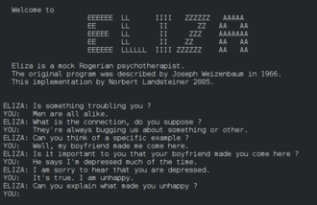
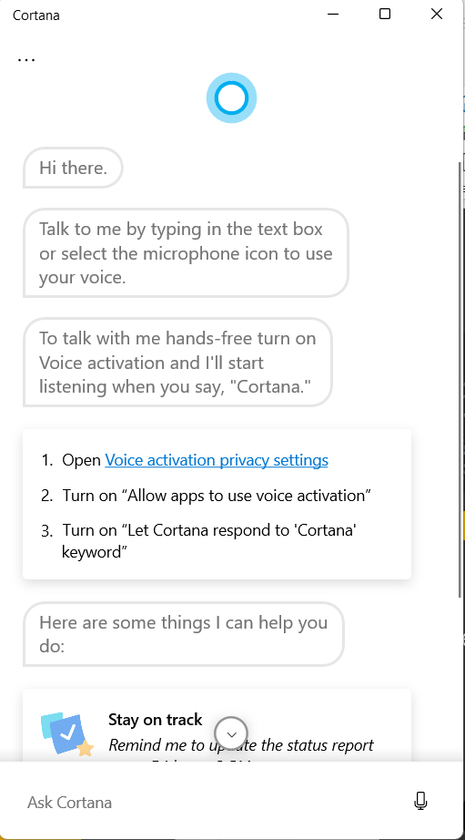
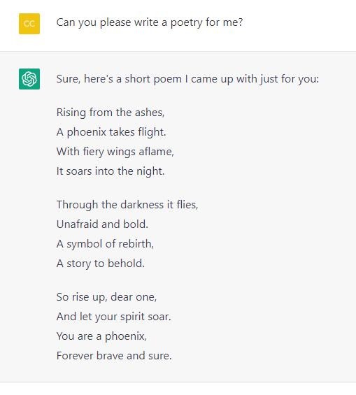
Let’s Go Back In Time
1980s – 1990s Return of AI research and birth of new statistical models
2010 - 2015
Modern assistants like Siri, Cortana, Google Assistant
Today
Generative AI based on Transformer architecture
1966 ELIZA
Typewritten chatbot simulating a psychiatrist
Notes:
let's break down the evolution and current state of AI and natural language processing in a fun and engaging way for your presentation:Back in the 1960s, AI pioneers started dreaming about teaching machines to think like humans, especially in conversations. They kicked off with symbolic reasoning, where machines followed strict rules. It worked for basics like Eliza, the chatbot therapist, but got stuck with complex stuff. This led to a "AI Winter" in the 1970s, a chilly time for progress.Fast forward to the 1990s! Technology got beefier, handling more data with cheaper hardware. Enter machine learning: algorithms learning from data without step-by-step programming. Imagine neural networks, inspired by our brains, crunching through more than just numbers – they handle images and sound too! Think of them as super-smart pattern detectors.Zoom into the 2010s, where Siri, Cortana, and Google Assistant stepped in. They ace Natural Language Processing (NLP), understanding and answering questions. Picture asking Siri for the nearest pizza joint – it gets you a spot-on answer fast!Today, we're in the age of Generative AI – think big, like really BIG data and super speedy calculations. These models churn out all sorts of things, from poetry to paintings, based on what they've learned from the vast internet sea. Imagine asking an AI to write you a poem – and boom, it delivers!So, buckle up! We're diving into a world where machines chat, learn, and create with us. Get ready to explore how AI and NLP are shaping our future – it's more than just hype, it's the real deal!

Slide 15
Language Models Progression
Notes:
Let’s cover a bit what’s behind the scenes of a language model.

Slide 16
How a NN “understands” a sentence
He had tea and she drank iced coffee.
27
24
30
31
23
28
29
25
26
1st: Split sentence into tokens and turns tokens into numbers.
Notes:
Let’s start by explaining how a neural network processes a sentence.
First of all, let me say that we are talking about statistical models, so it could be intuitive as those models work better with numbers more than words.
--Imagine teaching how a neural network processes a sentence like playing with a cool decoder ring. First off, these networks love numbers more than words, so our first mission is to transform words into numbers. Here's how we crack that code:Step 1: Chop the text into tokens—think of these as bite-sized pieces like word Legos. Tokens can be as small as a letter or big as a word, depending on the language. But for today, we'll swap between "token" and "word" to keep it simple.Step 2: Once we've got our tokens, we whip up a dictionary. It's like a word bank where each word gets a special number. This magic is done with cool algorithms—like the popular "bag of words"—that count how often each word shows up.By the end of this quick lesson, you'll have cracked the code on how neural networks chew through sentences—turning words into numbers for their mathematical brains to munch on.
Let’s start by explaining how a neural network processes a sentence.
First of all, let me say that we are talking about statistical models, so it could be intuitive as those models work better with numbers more than words. So the 1st challenge to face is: how to convert words in numbers?
There are 3 fundamental step to do that: 1st one – starting from a text, split it into smaller pieces – know as tokens. Now a token has a dimension which vary from a language to another, but that usually is between a character and a word. But to make things simple in this explanation we will be using the terms token and word interchangeably.
Once the text is split into tokens, we can build a dictionary such that every word is mapped with a number. There are multiple algorithms that do this kind of embeddings, a very popular one is called bag of words and create those mappings by taking into account the frequency of each word within the text.

Slide 17
How a NN “understands” a sentence
He had tea and she drank iced coffee.
27
24
30
31
23
28
29
25
26
27 | 24 | 30 | 31 | 23 | 28 | 29 | 25 | 26 | 0
10-dimensional vector
2nd: Standardize the length of your embedding space.
Notes:
Now, onto Step 2 of our neural network adventure: We're setting up a cozy space for our words to hang out—a place we call the "embedding space." Imagine it like a room where each word gets its own comfy chair in a row. But here's the twist: we're setting a standard size for each chair, say 10 seats in a row. So, we take our list of words-turned-numbers (thanks to our trusty dictionary) and line them up in our array of 10 spots. If our text doesn't fill all 10 spots, we toss in some placeholders—like adding extra seats for imaginary friends. This way, no matter if our sentence is short and sweet or a novel-length epic, our neural network knows exactly where to find each word's number in our tidy row of 10. And that's how we turn words into numbers and get our neural networks ready to do some serious thinking!
The 2nd step is defining a standard length for the embedding space, which means defining a standard size of the vector which represents my text. In our very simple example, we can set this dimension to 10, that means we build an array of 10 numbers , collecting the numbers mapped to the tokens, in the order they appear. If the input text is shorter than the pre-defined standard dimension, the rest of the array is populated using a place-holder, for example 0.

Slide 18
How a NN “understands” a sentence
He had tea and she drank iced coffee.
27
24
30
31
23
28
29
25
26
27 | 24 | 30 | 31 | 23 | 28 | 29 | 25 | 26 | 0
10-dimensional vector
x W
he
Weighted parameters
she
coffee
tea
iced
3rd: Train your model to learn the semantic weights of those relationships.
.
drank
.
=
had
Notes:
Once our text is neatly in this ten-spot vector, we feed it to a neural network for training. Here’s the scoop: each node in the network wakes up (or not) based on an activation function—a math magic show where numbers get weight. In our language game, these weights hold the meaning.The nodes pass the baton from input to output through layers—called forward propagation—where all the brainy work happens. This defines how deep our network goes.After training, we unlock a ten-spot world where tokens hang out in clusters by meaning. Words like "he" and "she," or "coffee" and "tea," cozy up close. Imagine this space as a 2D map—it helps us see how words relate, making our language adventure crystal clear.Ready to dive into this wordy wonderland?
Once my text has been converted to standard-length array of numbers, I can use this as input for the training of a neural network. The way this works –in simple terms - is that each node making up the network is activated (or not) by an activation function, calculated as a weighted sum of the inputs to a neuron. In the NLP domain, the weights embeds the semantic value. The output of a node is the input of the following one, in a chain – called forward propagation – from the input layers to the ouput layers of the network, passing through the hidden layers where the computations happen and that define how deep the network is.
From this training process I will get a space of dimension 10 where the tokens of my input text are represented grouped into clusters of similarity, such that words with similar meanings are closest one to another in the semantic space (e.g. he with she, coffee with tea). In this deck you can see the resulting space represented as a 2dimensional space, since it’s the most intuitive way for us to represent and understand the reality.

Slide 19
Context matters
She had coffee
She had strength
Encoder: encode a sequence of words into a complex idea
Semantic space
Compute with that idea in SEMANTIC SPACE
Decoder: decode back into your desired input
Lei ha preso il caffé
Lei ha forza
Notes:
Now, it’s easy to grasp as representing words in a semantic space in a way that similar words are in proximity one to another is not enough to represent the whole meaning of a sentence or a text. The reason is that context matters, i.e. the same word can assume a different meaning according to the context in which is used. And this is especially true for the English language.
Let’s take this example (she had coffee vs she had strength): the term ‘had’ has a very different meaning in the 2 sentences , and so it is true that in Italian for example you would use 2 different verbs. But how are we able to tell that the 2 terms ‘had’ have a different meaning in the 2 sentences: based on the context, which in this case means based on the word following the term ‘had’, coffee in one case, strength in the other case.
This means that we need to convert the words into ideas, such that the 2 ‘had’ are represented in the semantic space as two different items and the semantic proximity is computed on the idea, taking into account the context. This is exactly how the recurrent neural networks –commonly used in the NLP domain – work they process collection of words included into a pre-defined linear window, shifting throughout the text as the model reads and analyzes it.
Once we encoded my collection of words into a more complex idea inside the semantic space , it’s also possible to decode it into into the desired output, which varies according to the domain of application, and in the case of the translation will be the translated sentence in Italian. And the cool thing is that once you have the encoder and the decoder to translate from En to IT , you can apply them in the opposite direction and translate from Italian to En.
CNN – commonly used in computer vision kind of scenarios - work in a similar way: the pictures, split into a collection of pixels, are represented in the semantic space and then decoded into a textual output, like the description of what is shown in the image.

Slide 20
What’s new in Transformers model?
Mary already had had coffee that morning, so she didn’t accept a cup of iced coffee his colleague offered her.
Q. Why didn’t Mary accept the coffee?
Recurrent NNs are based on windows of words and the encoder’s parameters can be as smart as the sequence it sees.
The bigger the windows size the more the cost of training, the higher the complexity and probability of errors.
Notes:
At this point you can argue that RNNs are not so new, if those models were already able to do those type of computations, why the newest LLMs are so revolutionary? Well, the main limit of RNNs is indeed the concept at the basis of how they work. A RNN uses the so-called “immediate context”, which are a few words around the term in analysis. Where’s the issue?
Let’s imagine that we have this sentence and we wish our model being able to answer the question “ why didn’t Mary accept the coffee?” To answer to a question like this, our model should be able to correlate the expression “didn’t accept the coffee” with “she“, and then “she” with “Mary”, covering a quite long window of word. And greater is the dimension of the window, greater is the complexity of the model, the cost of its training and the probability of error.

Slide 21

What’s new in Transformers model?
Mary already had had coffee that morning, so she didn’t accept a cup of iced coffee his colleague offered her.
ATTENTION lets deep networks learn meaning without proximity
The transformer model is able to look at different combinations at the same time, leading to powerful encoders, smarter and time/energy efficient.
Notes:
The invention enabling the revolution in the deep networks domain has been the mechanism of attention. Again, inspired by the cognitive capability of the human brain of giving a different weight to the input we receive, such that we can focus for example on a voice speaking to us and isolate it from noisy background, similarly the basic idea of the deep network attention mechanism is that each time the model tries to predict an output word, it only uses parts of an input where the most relevant information is concentrated instead of an entire sentence.
A new neural network architecture has been built upon attention mechanism – called Transformer ; this architecture uses what is called multi-head attention, combining multiple heads (as they were multiple intelligences) in a way that the model can attend to different parts of the input sequence simultaneously, analyzing multiple possible combinations of words relations. This allows to overcome the linear and fixed-size window of word of the RNNs., empowering deep networks to learn semantic meaning without proximity.
A transformer architecture is always made up of an encoder and a decoder; in the example of the translation, the encoder has as input the sentence to translate, while the encoder has as input the hidden state (which means the part of sentence already translated); the output of the decoder is the next translated token, chosen from a list of possible next tokens according to its probability. In the case of the most recent LLMs as GPT-3 not always the next token with the highest probability is chosen, but a degree of randomness is added in this choice, in a way that the model is not deterministic (we do not have always the same output for the same input). This degree of randomness is added to simulate the process of creative thinking and it can be tuned using a parameter called temperature (> temp, > degree of randomness).

Slide 22
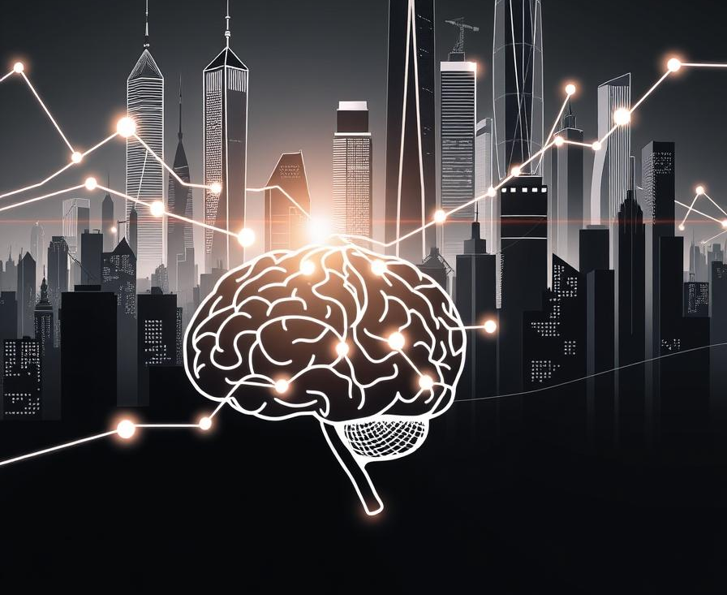
The rise of generative models
Generative AI is a deep-learning model that can generate statistically probable outputs from raw data.
It has been used in statistics for years, but the rise of deep learning has allowed it to extend to images, speech, and other complex data types. Variational autoencoders (VAEs) were the first deep-learning models to achieve this feat.
Future models will be trained on a broad set of unlabeled data for different tasks, with minimal fine-tuning.
Foundation models, trained on large, unlabeled datasets, are driving this shift.
Foundation models are predicted to accelerate AI adoption in enterprise, enabling more companies to deploy AI in mission-critical situations.

Slide 23
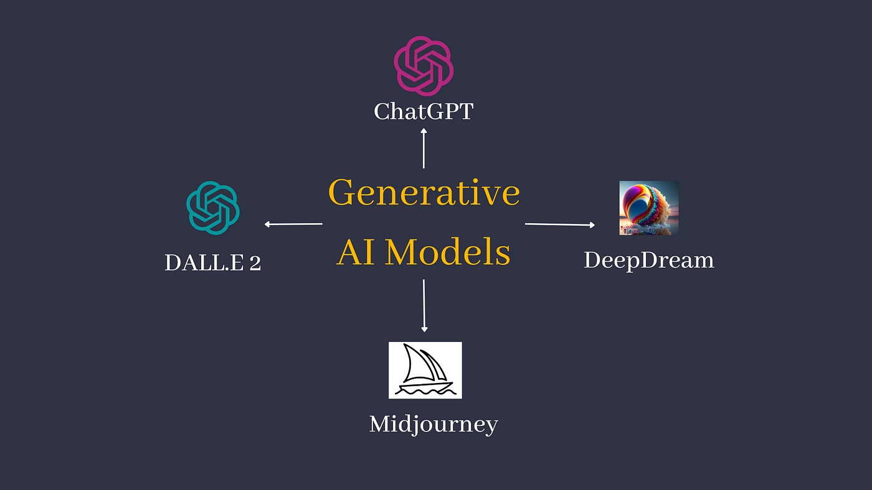

Slide 24
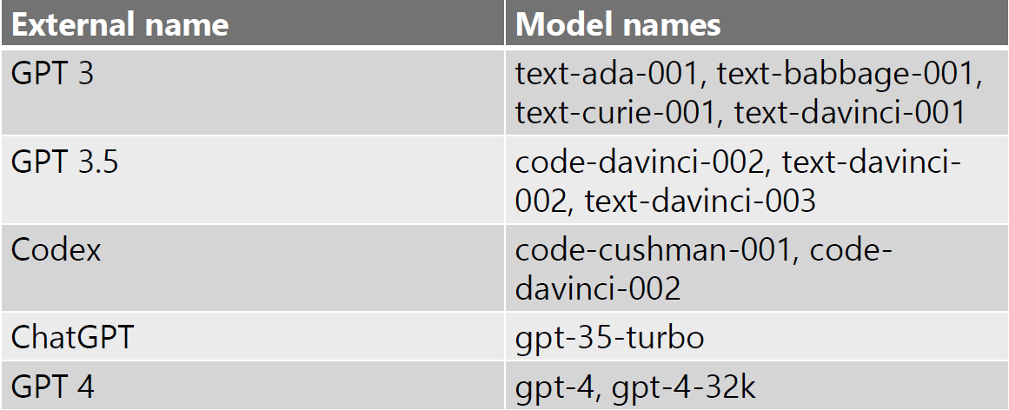
GPT model generations
Billions of parameters
aka.ms/AOAI-models
0.1B
1.5B
175B
100T
GPT-1
GPT-2
GPT-3
GPT-4
Notes:
et's break down the key points about GPT models and their evolution in a clear and engaging way:
What is a Transformer in GPT?
In GPT (Generative Pre-trained Transformer), "Transformer" refers to the model architecture used. It's designed to learn the general patterns of language from diverse sources like books, articles, and websites. This allows the model to understand and generate human-like text.
Evolution Across Generations:
GPT has evolved through different generations, starting with GPT-1 in 2018 up to the latest GPT-4. Each new version has grown significantly in size and capability. For example, GPT-4 is much larger than GPT-3.5, with 500 trillion parameters, enabling it to handle more complex tasks and improve performance.
Increasing Parameters = More Knowledge:
As each GPT model grows in size (measured by parameters), it becomes more knowledgeable. This means it can understand and generate more nuanced and accurate responses across various domains like conversations, literature, mathematics, music, and medicine.
Application Beyond Training Data:
Despite being pre-trained on vast amounts of data, GPT models can apply their knowledge to tasks they weren't explicitly trained for. This flexibility makes them versatile tools for diverse applications.
Model Families and Capabilities:
Each generation of GPT models includes different families (like ada, Babbage, curie, davinci), each with varying capabilities and costs. These names are organized alphabetically to indicate increasing capability (e.g., curie > ada, davinci > curie).
Continuous Improvement and Safety:
With more usage, GPT models are continually analyzed for their outputs and behaviors. Insights from these analyses help refine and enhance future generations, ensuring safer and more reliable performance.
By understanding these points, you can convey how GPT models have advanced over time, their capabilities across different domains, and their impact on various applications. This approach should make your presentation both informative and engaging for your audience.
So that is what the term transformer stands for in the name GPT. GPT generations of models include models trained with a vast amount of unsupervised data from various sources – including books, articles, websites and more- such that the model can learn a general representation of the language, which can then be fine-tuned for specific tasks – like ChatGPT which has been built from GPT-3.5 and fine tuned for the conversation domain or InstructGPT, optimized to execute user instructions – written in natural language – throught prompts. We can observe a progression throughout the years from the very first GPT model (GPT-1), born in 2018, trained with hundreds of million of parameters up to the very new GPT-4 model,much larger, trained on hundreds of trillions of parameters, 500 times bigger than GPT-3. The size of parameters increased more and more from one version to the next one, together with the dimension of the semantic space, resulting in better performance and efficiency of the model – in simpler terms the more parameters mean more knowledge.
However, the size of the model is not the only criterion to consider in terms of evolution of the models; the model has evolved also in terms of the variety of different domains or modalities that can handle and its capacity to apply knowledge and skills across different contexts or disciplines. For example, GPT4 demonstrate a high level proficiency not only in conversation or literature, but also mathematics, music, medicine and accepts both text and visual inputs. Also, as those models had evolved and have been used by more and more users, it is also possible to analyze prompts and corresponding behaviors and use those insights to continuously improve and refine the next generation of the model, mitigating the risk of unsafe and undesired outputs.
In addition to different generation of the models, you might have heard about different families of models per generation – you can see the mapping in the table in the right side of this slide. Those families (like ada, Babbage, curie or davinci) identify the relative capability and cost; their names are ordered in alphabetical order in a way to more easily identify a more capable model (curie is more performant then ada, davinci is more capable than curie).
However, all those model generations share the same operating principle: being pre-trained models (on huge corpus of data) they are able to “apply” their knowledge on tasks they were not explicitly trained for.

Slide 25
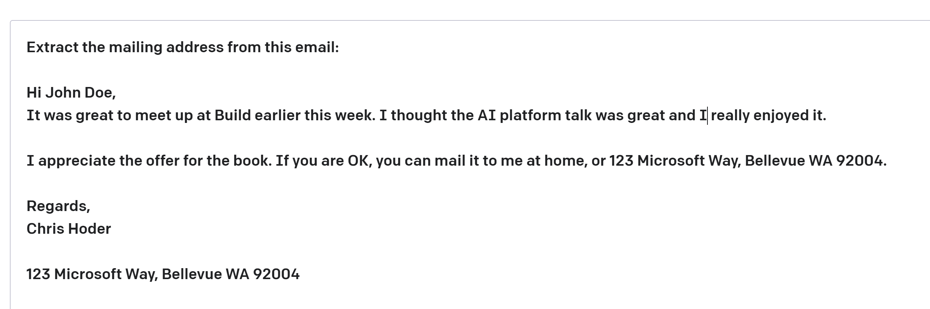
| Key Terms
some context
Prompt—Text input that provides some context to the engine on what is expecting.
Completion—Output that the model generates based on the prompt.
Token — partial or full words processed and produced by the GPT models
Notes:
Prompt: This is the starting point for the AI model, like the beginning of a sentence it needs to finish.
Completion: It's what the AI generates in response to the prompt. It fills in the blanks based on what it knows.
Token: Think of tokens as the building blocks of language the AI uses. Each word, punctuation mark, or even space is a token.
Prompt Engineering: This is like crafting the perfect question or hint to get the best answer from the AI. It's about tweaking the prompt for the desired outcome.
For example, if you ask an AI, "Complete the sentence: 'The quick brown ___,'" it should ideally respond with "fox" because that's a common completion. So, prompt engineering helps us get the most accurate and useful responses from AI models.
Let’s look in more details at the key terms and concepts shared by all those models.
The prompt is generally a natural language textual input to the model. According to the different use cases, it can simply contain the incipit of a sentence to complete or an additional context providing guidance about the task to execute and/or few examples of the desired output.
Completion: it is the model output, generated starting from the given prompt (and of course starting from the data on which the model has been trained). The output is generated one token at a time, according to its probability of completing the current text.
Token: it’s the smallest unit in which language models split the text to process it.
Another concept that you might have heard of is prompt engineering. It’s the accurate design of a prompt to optimize and customize the output for our needs.

Slide 26
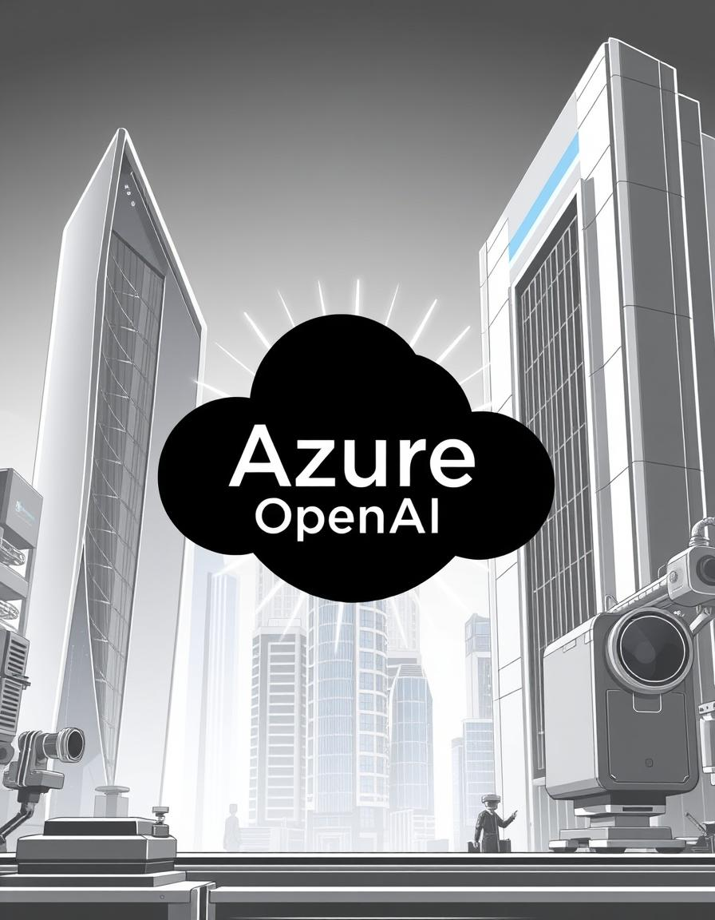
Azure OpenAI
Azure OpenAI Service is a cloud-based platform provided by Microsoft Azure that allows businesses and developers to integrate and leverage OpenAI's powerful language models, such as GPT-3, into their applications.
This service offers the advanced capabilities of OpenAI models for a variety of tasks, including natural language understanding, text generation, translation, and more, all within the robust and scalable infrastructure of Azure.

Slide 27
OpenAI + Microsoft

Slide 28


Microsoft and OpenAI partnership
Ensure that artificial general intelligence (AGI) benefits humanity
Empower every person and organization on the planet to achieve more
GPT-3.5 and GPT-4
ChatGPT
Codex
DALL·E 2
Text
Conversation
Code
Images
Notes:
Microsoft have a very public partnership with OpenAI
Open AI trying to build systems that build general intelligence – a real shift in what can be done with machine learning
Normally very specific models solving specific problems
Partnered about 4 years ago in 2019 – worlds most advanced supercomputing infrastructure that they train the models on, in turn we get to use those models to build the platform
In our own platforms as well as packaging up for customers to build their platforms on
GPT4 build on Azure using specialized hardware

Slide 29

GPT-3.5 and GPT-4
ChatGPT
Codex
DALL·E 2
Text
Conversation
Code
Images
Prompt
Write a tagline for an ice cream shop.
Prompt
I’m having trouble getting my Xbox to turn on.
Prompt
Table customers, columns = [CustomerId, FirstName, LastName, Company, Address, City, State, Country, PostalCode]
Create a SQL query for all customers in Texas named Jane
query =
Prompt
A ball of fire with vibrant colors to show the speed of innovation at our media and entertainment company
Response
There are a few things you can try to troubleshoot this issue … …
Response
We serve up smiles with every scoop!
Response
Prompt
Thanks! That worked. What games do you recommend for my 14-year-old?
Response
SELECT *
FROM customers
WHERE State = 'TX' AND FirstName = 'Jane'
Response
Here are a few games that you might consider: …
Notes:
GPT3 – GPT3.5 AND GPT 4 now - can understand and generate text. providing a prompt this model will generate an answer with natural language (image inputs coming in the future)
Codex – translates natural language to code, powers Github Co-Pilot, proficient in a dozen programming languages, a descendant of GPT3 model
DALLE – created original and realistic art from a text description
ChatGPT – interacts in a conversational way, conversation allows for follow up questions that hold context

Slide 30



Azure OpenAI Data and Privacy
2
Microsoft Cloud
Deployed within your Azure subscription, secured by you, accessed only by you, and tied to your datasets and applications
3
2
Data governance
Enterprise-grade security with role-based access control (RBAC) and authentication
Analytics
1
Operational databases
2
Secure networking through private endpoints and VNETs
Microsoft Intelligent Data Platform
AI

Slide 31
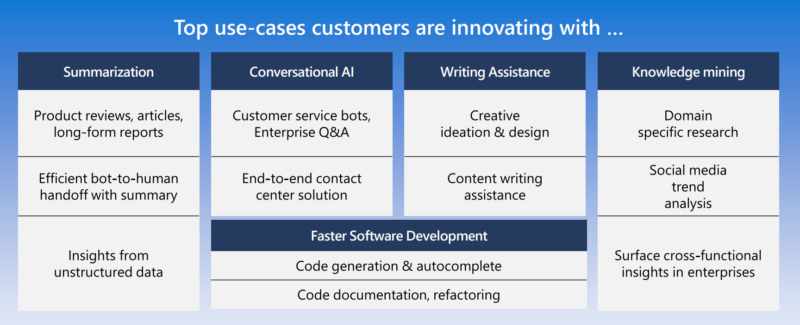

Slide 32
Azure AI $≠$ Azure Open AI Service
¹General guidance is to start with Davinci and then go down to see if a less sophisticated model can repeat the same results

Slide 33
Azure AI
Applications
Partner Solutions
Business Users
Application Platform
AI Builder
Power BI
Power Apps
Power Automate
Power Virtual Agents
Scenario-Based Services
Applied AI Services
Bot Service
Cognitive Search
Form Recognizer
Video Indexer
Metrics Advisor
Immersive Reader
Customizable AI Models
Azure OpenAI Service
Cognitive Services
Developers & Data Scientists
Vision
Speech
Language
Decision
ML Platform
Azure Machine Learning
Notes:
Azure Open AI Service is not the only service available to you - considering the use case is key
Do you need to manage the service yourself or is this built into another Microsoft product you could leverage such as power platform (AI builder)
Our scenario-based services are built from understand strong use cases that our customers need across sectors. By already combining cognitive services together for an easier building experience you may find them a better fit
Open AI Service is fantastic for natural language processing/text input – processing text, conversation or creating text based of images. However, analyzing images, videos etc is another area of machine learning
Azure Machine Learning for your bespoke models, full management and deployment of those models
Narrative/talk track:
Azure AI is a collection of artificial intelligence services offered by Microsoft as part of its Azure cloud platform. The Azure AI services are designed to make it easy for developers and organizations to add AI capabilities to their applications, without the need for extensive expertise in AI.
Azure AI includes a wide range of services, such as:
Azure Cognitive Services: A collection of pre-built APIs that allow developers to add capabilities such as natural language understanding, computer vision, and speech recognition to their applications.
Azure Machine Learning: A cloud-based platform that allows developers to build, deploy, and manage machine learning models, as well as to create custom machine learning algorithms.
Azure Applied AI Services: A suite of scenarios-based services that enable organizations to accelerate adoption such as Azure Cognitive Search which provides search capabilities over structured and unstructured data by using machine learning models.
These services are integrated with Azure platform, which provides capabilities such as scalability, security, and compliance, as well as a number of other tools and services that can be used to build and deploy AI-enabled applications.
The Azure AI services are designed to make it easy for developers and organizations to add AI capabilities to their applications, without the need for extensive expertise in AI. Microsoft's Azure AI services allow developers to quickly build, deploy, and scale AI-enabled applications, and to take advantage of the scalability, security, and compliance capabilities of Azure.
Azure AI integration in AI Builder within the Microsoft Power Platform allows businesses and developers to quickly and easily build and deploy custom AI models, and to integrate them with Power Apps, Power Automate and Power Virtual Agents, in order to add advanced capabilities and improve data management and security. It also allows to easily scale up and improve performance of the models, as well as easily integrating with other Azure services.
Microsoft has adopted Azure AI across a wide range of its products and services, in order to improve the functionality, performance and user experience. Some examples of where Microsoft has adopted Azure AI at scale include:
Office 365: Microsoft has integrated Azure AI capabilities into Office 365, such as natural language processing, computer vision, and text analytics, to improve the functionality of products such as Outlook and Word. This allows users to perform tasks such as automatically summarizing long documents, or automatically tagging images in email attachments.
Dynamics 365: Dynamics 365 is a collection of business applications that enable organizations to manage customer data and interactions, as well as automate business processes. With Azure AI integration, Dynamics 365 offers features like predictive lead scoring, sentiment analysis, and chatbots to help businesses better understand and interact with their customers.
Bing: Bing, Microsoft's search engine, uses Azure AI to analyze large amounts of data and improve search results for users. For example, Bing uses natural language processing to understand users' queries and generate more relevant search results.
LinkedIn: Microsoft's professional networking site, LinkedIn, uses Azure AI to help users find job opportunities, connect with others in their field, and improve the performance of its recruiting tools. For example, LinkedIn uses natural language processing to match job seekers with relevant job opportunities, and uses machine learning to help recruiters find the best candidates.
Xbox and Gaming: Microsoft uses Azure AI to power its Xbox gaming console. Azure AI allows Xbox to learn a gamer's preferences and automatically adjust the gaming experience. Additionally, it allows to improve the performance of the games and to offer more personalized gaming experiences.
These are just a few examples of how Microsoft has adopted Azure AI at scale within its products and services. Overall, Microsoft has been using Azure AI across its various products and services, to improve user experience and to offer more personalized, efficient and automated experiences to its customers.

Slide 34




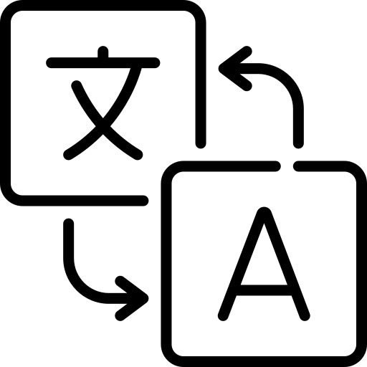

Azure OpenAI | Considerations
I need a general-purpose model that can handle multiple tasks.
e.g. translation+entity recognition+sentiment analysis
I need to generate human-like content, whilst preserving data privacy and security
e.g., abstractive summarization, content writing, paraphrasing, code
I need rapid prototyping and quick time to market for many use cases
I could use a model with little or no training
I want to explore solutions / use cases that have been described previously
Azure OpenAI Service
Vision
Speech
Language
Decision
Azure AI Cognitive Services
Notes:
Breaking down the custom AI models section …
When to prefer Azure OpenAI upon other Azure AI services:
Here are typical consideration points that we ask our customers to ask themselves.
If you have said yes to all of the above, then OpenAI may be the right cognitive service to go with. If you haven't checked yes to all of the above or due to any other factors we may come across when doing a deep dive on your use case, we have our other cog services which may cater better to the scenario that we are working with you on. We could also have situations where one of the other cog services may be needed as a complementary service with OpenAI for your particular scenario.
Complexity needed – one service only
Specific language used in domain – LUIS may be a better fit for more control right now
Natural Language processing scenarios

Slide 35
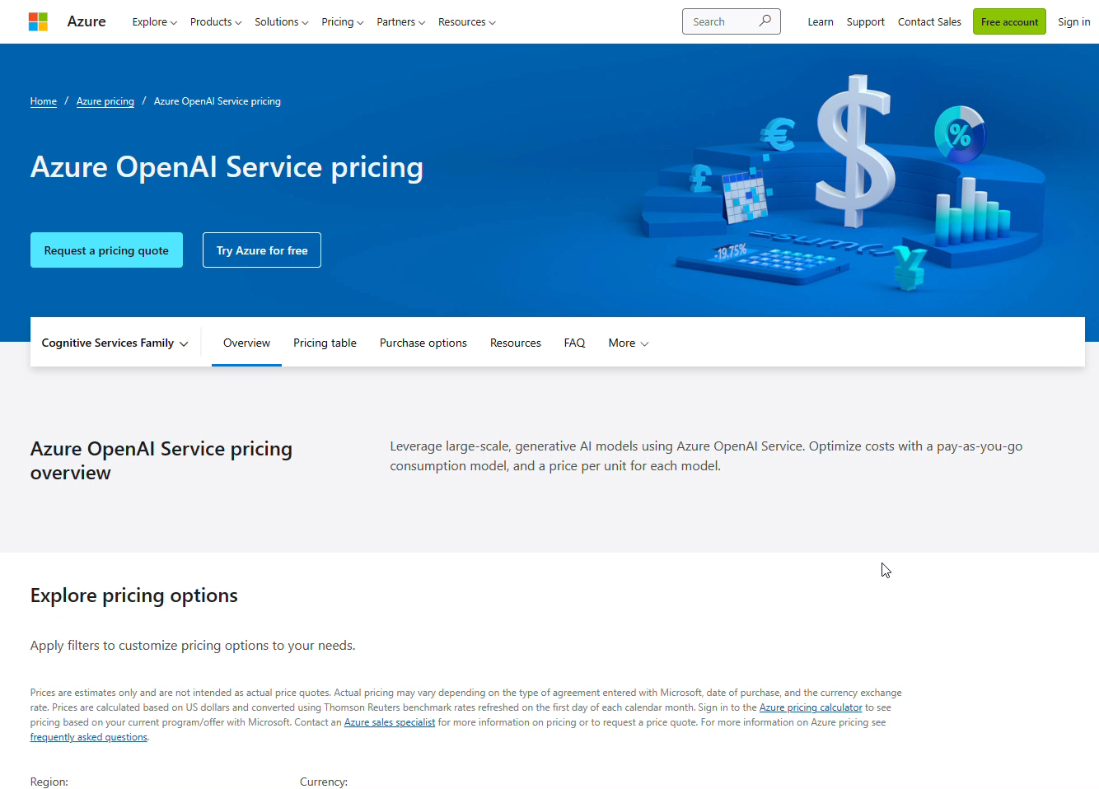
aka.ms/AOAI-models
Notes:
Pricing is a little more complex than other cognitive services currently
Choosing your models
If you fine tune consider the extra compute hours needed to process and host
Regional availability – still a new service, if data needs to stay in a region other cognitive services may still be more appropriate

Slide 36
Using AI responsibly: social implications

Slide 37

Do not humanize AI!
Generative AI
is not:
Intelligent
Deterministic
Grounded
Generative AI
can not:
Understand language or maths
Understand manners or emotions
Know facts that are not in its training dataset
Image created by DALL E2
Always ensure to use AI output responsibly.
Notes:
The output of a generative AI model is not perfect and sometimes the creativity of the model can work against it can, resulting in an output which is a combination of words that the human user can interpret as a mystification of reality or it can be offensive. In those cases we talk about model’s hallucinations. We’ve covered how a large language model works to highlight that behind what looks like magic that’s no more than a statistical model. Generative AI is not intelligent (at least in the more comprehensive definition of intelligence, including critical and creative reasoning or emotional intelligence); it is not deterministic, since as we explained beforehand it adds a certain degree of randomness when selecting the next token to output; it is not trustworthy, since hallucinations, such as erroneous references, content, and statements, may be combined with correct information, and presented in a persuasive and confident manner, making their identification difficult without close inspection and effortful fact-checking.
It is not able to understand language or math and it doesn’t know fact that are not in its training dataset (for example GPT-3 doesn’t know about Queen Elizabeth’s death).
When we work with those kind of technologies, it’s very important to know not only the power and the capabilities but also the limitations. Especially because those limitations might have significant social impacts when this technology is applied in sensitive scenarios.

Slide 38



How to mitigate hallucinations
Effective prompt engineering
Tweak parameters (temperature/max length)
Content filtering
Provide validated data sources
Ask for citations
Notes:
We have a few tools to mitigate the impact of hallucinations:
Designing effective prompt, as the ones used in the demo, enabling the model to customize the answers for our scenario and our users
Providing (through the prompt) validated data sources and ask the model to cite them in the answer, in a way that the users can double check the correctness of the information on their own
Tweaking parameters – like temperature which handles the degree of randomness or max length of the output); Applying content-filtering: AOAI service includes a content management system based on an ensemble of classification models aimed at detecting misuse on the prompt and on the output of the model. Applying those filters into your application that uses the model, you can reduce the risk of harmful use of it.

Slide 39
Thank You

